Slide 1

TASTYFOOD APP DESIGN
PAVITHRA MNS

Slide 2
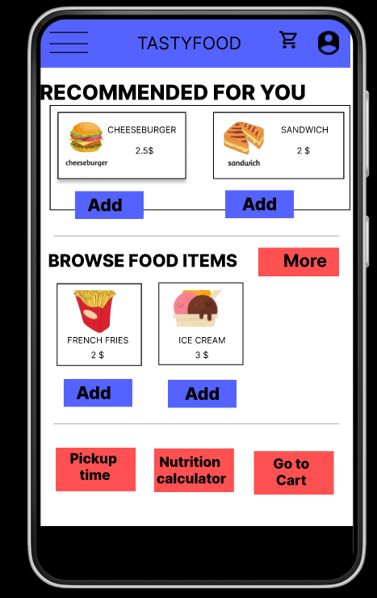
Project overview
The product:
TASTYFOOD app is a food delivery app for TASTYFOOD food truck which aims at delivering fast foods and healthy foods to customers who love ordering foods or have a busy schedule.
Preview of selected polished designs.
Project duration:
October 7th 2022 to October 31st 2022

Slide 3
Project overview
The problem:
Busy people lack time to prepare food or pick up food from food trucks.
The goal:
Design an app for TASTYFOOD food truck which allows users to order food in an easy and efficient way.

Slide 4
Project overview
My role:
UX designer designing an app for Zia’s Pizza from conception to delivery.
Responsibilities:
Conducting interviews, paper and digital wireframing, low and high-fidelity prototyping, conducting usability studies, accounting for accessibility, and iterating on designs.

Slide 5
User research
Personas
Problem statements
User journey maps
Understanding
the user

Slide 6
User research: summary
I conducted interviews and created empathy maps to understand the users I’m designing for and their needs. A primary user group identified through research was busy people who don’t have time to cook food or pick up food.
This user group confirmed initial assumptions about TASTYFOOD’s customers, but research also revealed that time was not the only factor limiting users from cooking at home. Other user problems included obligations, interests, or challenges that make it difficult to get groceries for cooking or go to restaurants in-person.

Slide 7
User research: pain points
1
2
3
4
TIME
ACCESSIBILITY
IA
HEALTH-CONSCIOUS
Working people are busy to cook food or pick up food.
Many websites are not accessible - friendly.
Text-heavy menus in apps are often difficult to read and order from
Many websites do not have nutrition calcaulators which are preferred by health - conscious people.

Slide 8
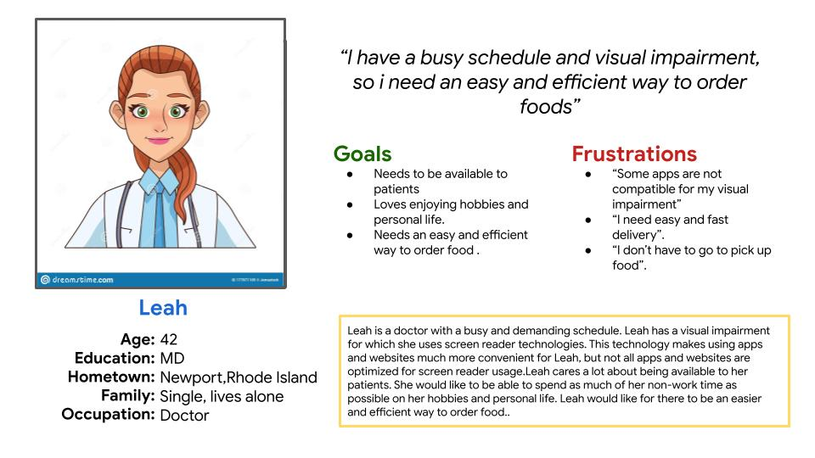
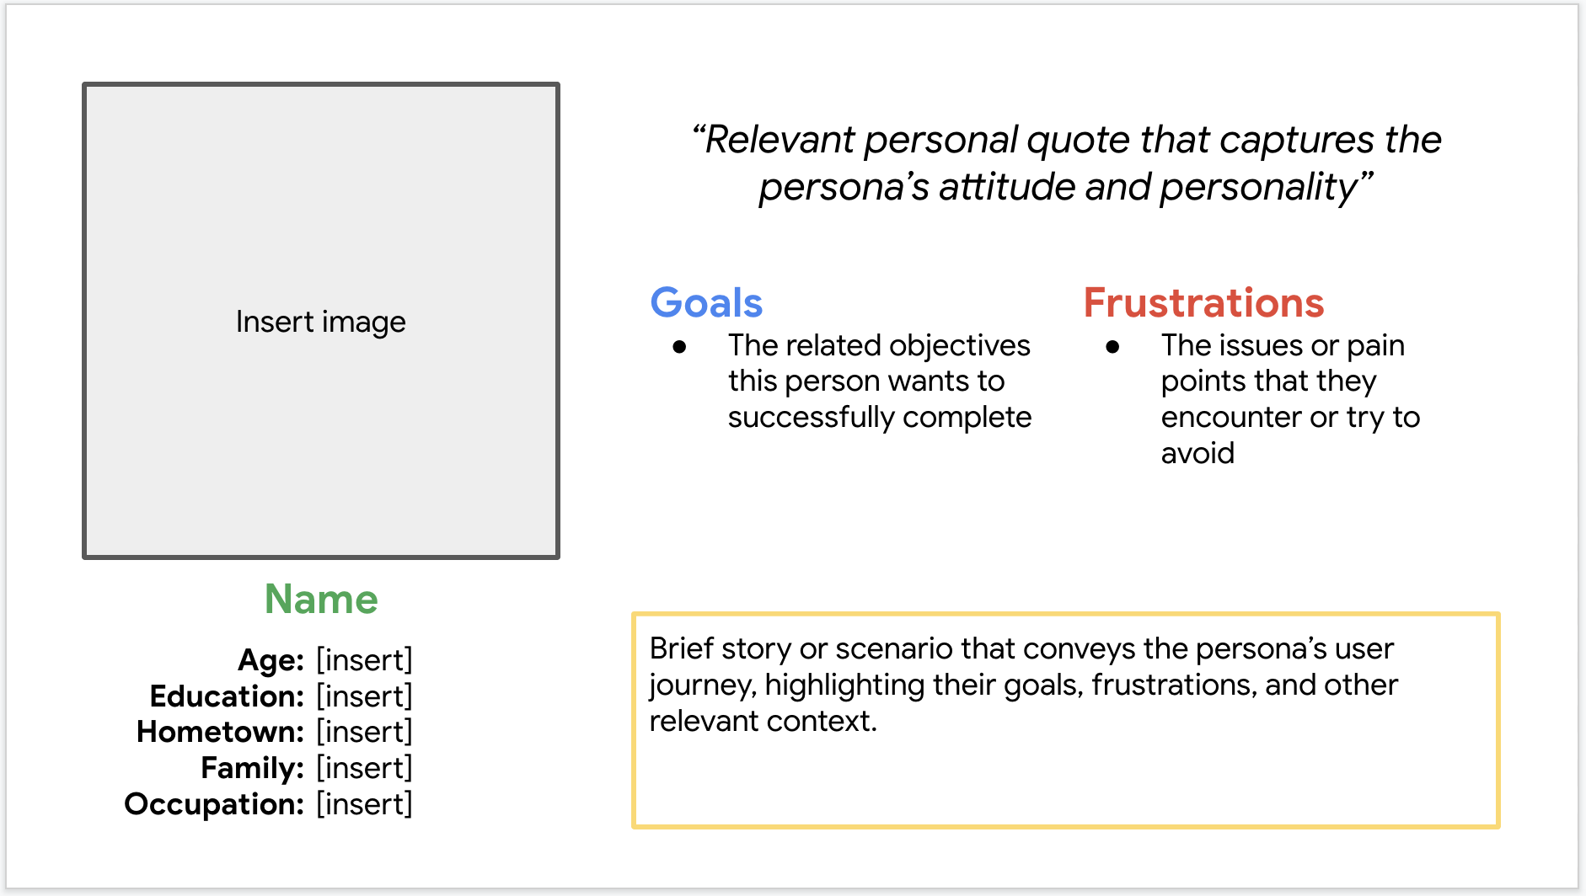
Persona: Leah
Problem statement:
Leah has busy schedule so they need an easy and efficient way to order food.

Slide 9
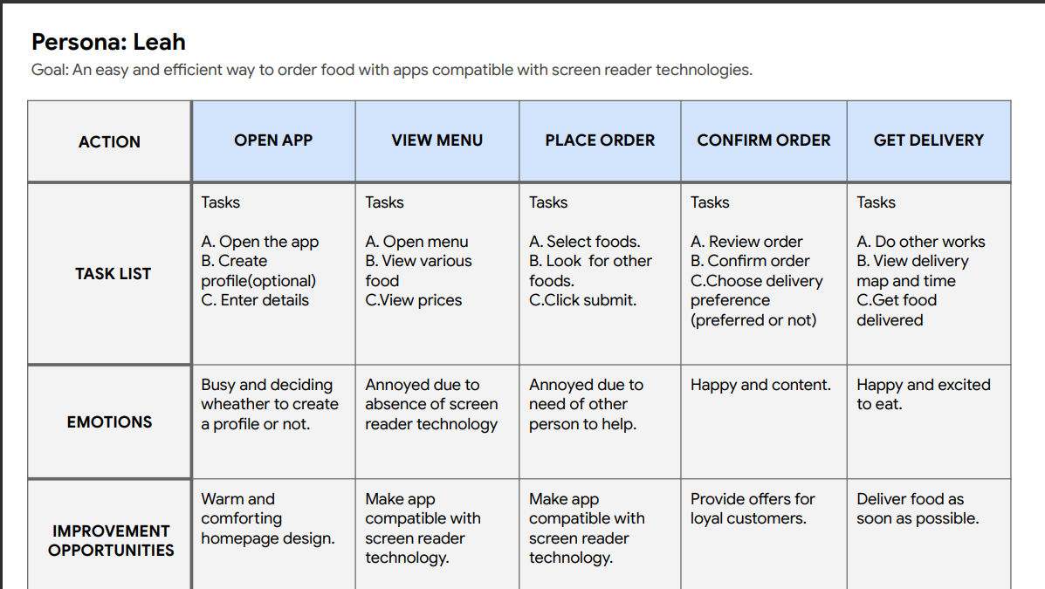
User journey map
Mapping Leah’s user journey revealed how helpful it would be for users to have access to a dedicated TASTYFOOD app.
Image of user journey map

Slide 10
Paper wireframes
Digital wireframes
Low-fidelity prototype
Usability studies
Starting
the design

Slide 11
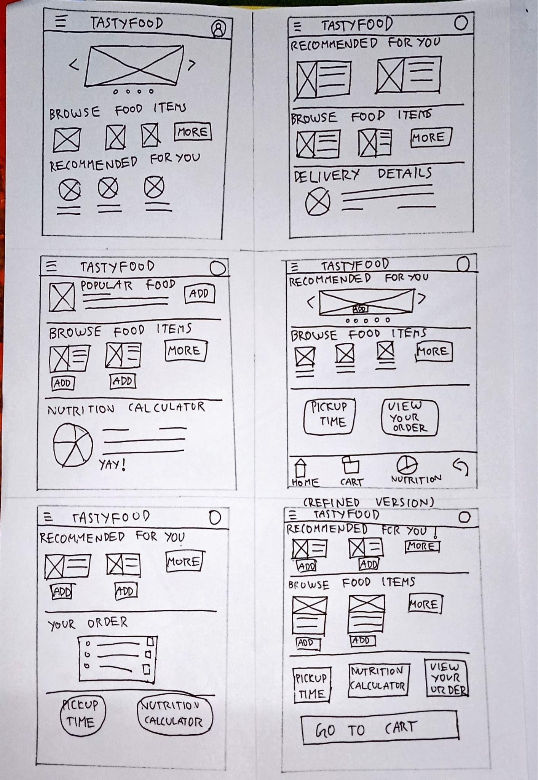
Paper wireframes
Taking the time to draft iterations of each screen of the app on paper ensured that the elements that made it to digital wireframes would be well-suited to address user pain points. For the home screen, I prioritized a quick and easy ordering process to help users save time.
Image of paper wireframes including five different versions of the same screen and one image of the new, refined version

Slide 12
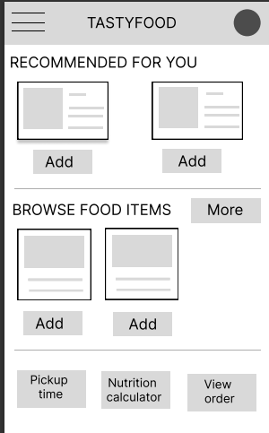
Digital wireframes
Favourite recommendations
As the initial design phase continued, I made sure to base screen designs on feedback and findings from the user research.
Insert first wireframe example that demonstrates design thinking aligned with user research
Easy navigation

Slide 13
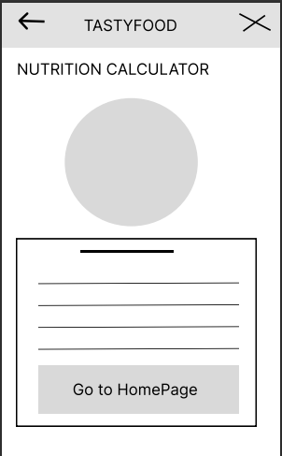
Digital wireframes
Calculates nutrition
Nutrition calculator is useful for health - conscious people.
Insert second wireframe example that demonstrates design thinking aligned with user research
Helps users who are health - conscious

Slide 14
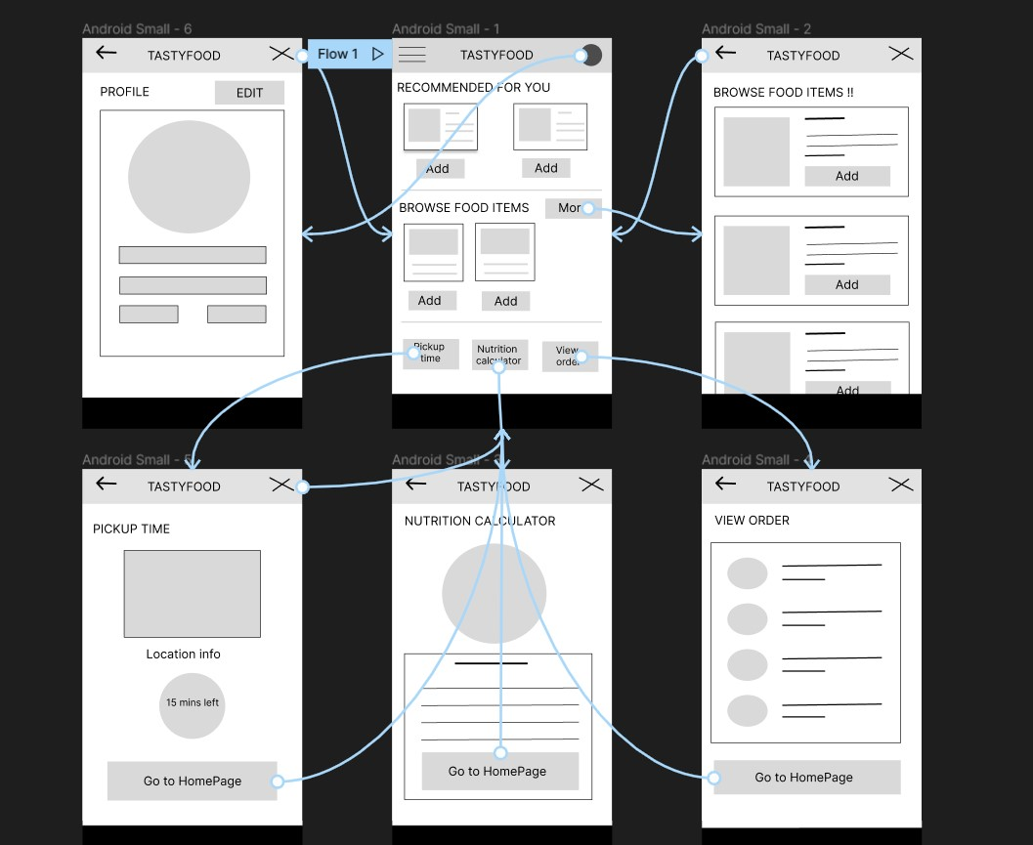
Low-fidelity prototype
Using the completed set of digital wireframes, I created a low-fidelity prototype.
Screenshot of prototype with connections or prototype GIF

Slide 15
Usability study: findings
I conducted two rounds of usability studies. Findings from the first study helped guide the designs from wireframes to mockups. The second study used a high-fidelity prototype and revealed what aspects of the mockups needed refining.
Round 1 findings
Round 2 findings
1
Users want a cart option
1
Users want Hamburger menu
2
Users want an easy user flow.
2
Users want a confirmation page
3
Users want more buttons for navigation
3
Users want to go to homepage from any screen

Slide 16
Refining
the design
Mockups
High-fidelity prototype
Accessibility

Slide 17
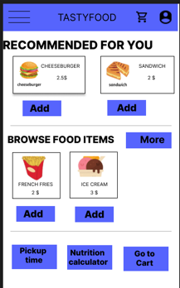
Mockups
Before usability study
After usability study
I used the insights gained from usability studies to reframe my app into a more easy to use app with easy user flow and addition of more screens.
Image of selected screen before usability study
Image of selected screen after usability study

Slide 18
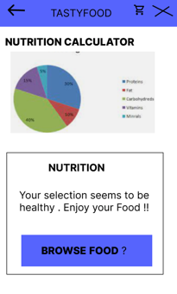
Mockups
Before usability study
After usability study
I used the insights gained from usability studies to reframe my app into a more easy to use app with easy user flow and addition of more screens.
Image of selected screen before usability study
Image of selected screen after usability study

Slide 19
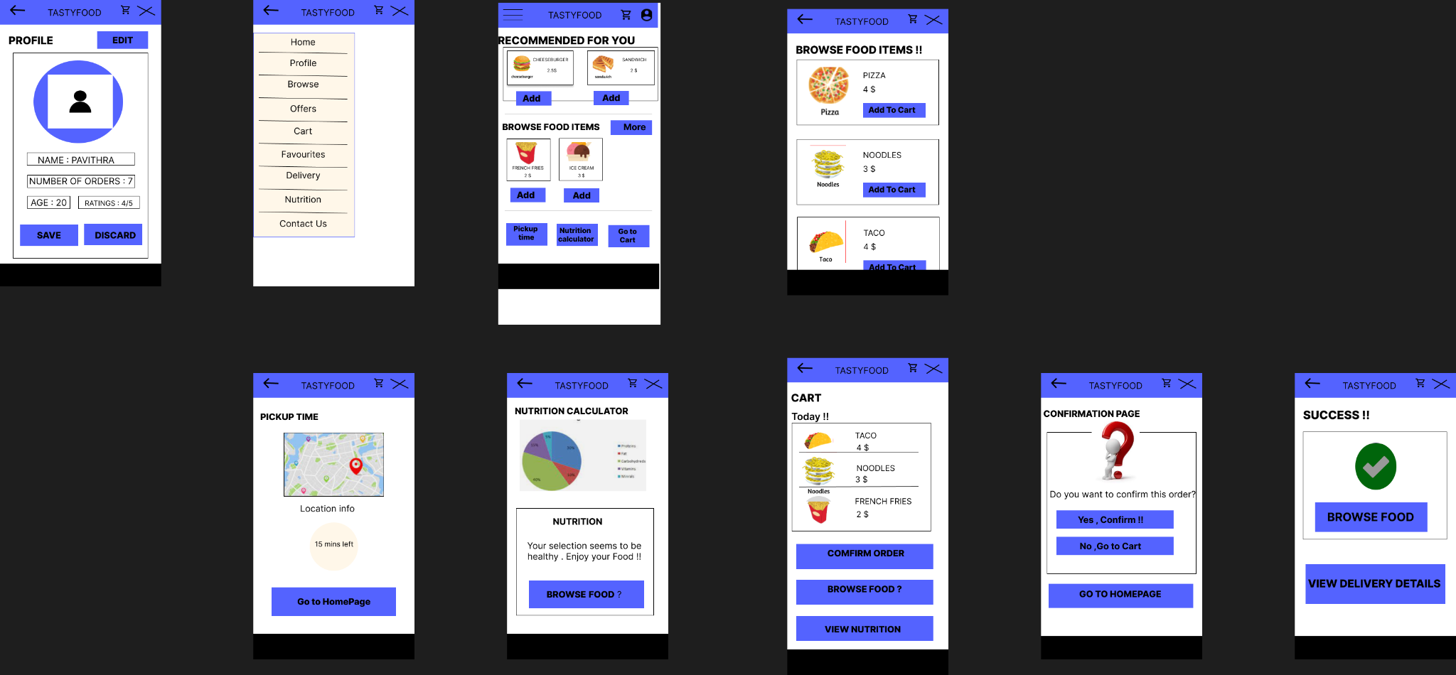
Mockups
Main mockup screen for display
Main mockup screen for display
Main mockup screen for display
Main mockup screen for display

Slide 20
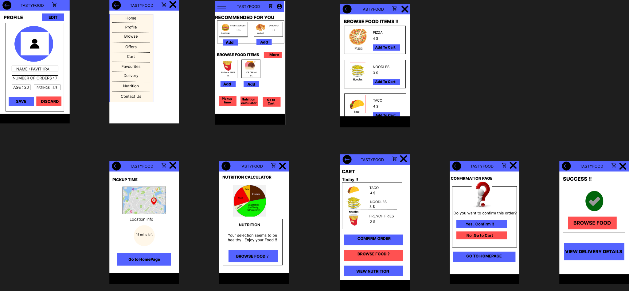
High-fidelity prototype
The final high-fidelity prototype presented cleaner user flows for easy food ordering.
LINK : FOOD DELIVERY APP
Screenshot of prototype with connections or prototype GIF

Slide 21
Accessibility considerations
1
2
3
Used icons to help make navigation easier.
Used detailed imagery for food items to help all users better understand the designs.
Provided access to users who are vision impaired through adding alt text to images for screen readers.

Slide 22
Going forward
Takeaways
Next steps

Slide 23
Takeaways
Impact:
TASTYFOOD app provided an easy way to order food for busy customers.
QUOTE : “ I loved this app . It’s visually appealing and helped me to order and get food delivered easily. “
What I learned:
While designing the TASTYFOOD app, I learned that it takes more iterations to build an effective app.

Slide 24
Next steps
1
2
Conduct another round of usability studies to validate whether the pain points users experienced have been effectively addressed.
Conduct more user research to determine any new areas of need.
Conduct more user research to determine any new areas of need.

Slide 25
Insert a few sentences summarizing the next steps you would take with this project and why. Feel free to organize next steps in a bullet point list.
Let’s connect!
Thank you for your time reviewing my work on the TASTYFOOD app! If you’d like to see more or get in touch, my contact information is provided below.
Mail id : mns.pavithra@gmail.com

